Slide 1
Android source build Guide
중앙연구소 System 개발팀
주임 연구원 이종찬

Slide 2
목 차
preinstall
  essential packages
  jdk install
  repo
  Path setting
Source
  git
  sync
Complie
  Enviroment
  Target setting
Output Binary
tip

Slide 3



preinstall
Linux System이 갖추어진 환경
  실머신
  가상머신 (virtural box, vmware, kvm, xen)
Linux 환경
  Ubuntu
  Fedora, gentoo, linux like cygwin(X)
Linux 설치된 환경

Slide 4
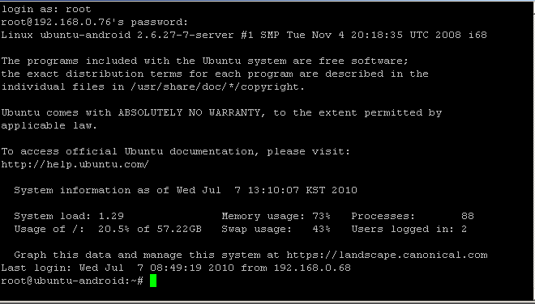
preinstall

Slide 5
preinstall
Root 계정 활성화
ssh service 설치 및 서비스 구동
ip address 확인
assa@ubuntu-android:~# sudo passwd root
Enter new UNIX password:
Retype new UNIX password:
assa@ubuntu-android:~# apt-get install ssh
assa@ubuntu-android:~# /etc/init.d/ssh start
* Starting OpenBSD Secure Shell server sshd [ OK ]
assa@ubuntu-android:~# ifconfig
eth0 Link encap:Ethernet HWaddr 00:0c:29:e0:ef:57
inet addr:192.168.0.76 Bcast:192.168.0.255 Mask:255.255.255.0
inet6 addr: fe80::20c:29ff:fee0:ef57/64 Scope:Link
UP BROADCAST RUNNING MULTICAST MTU:1500 Metric:1
RX packets:6436934 errors:11 dropped:14 overruns:0 frame:0
TX packets:905306 errors:0 dropped:0 overruns:0 carrier:0
collisions:0 txqueuelen:1000
RX bytes:3409448628 (3.4 GB) TX bytes:90977125 (90.9 MB)
Interrupt:19 Base address:0x2000

Slide 6
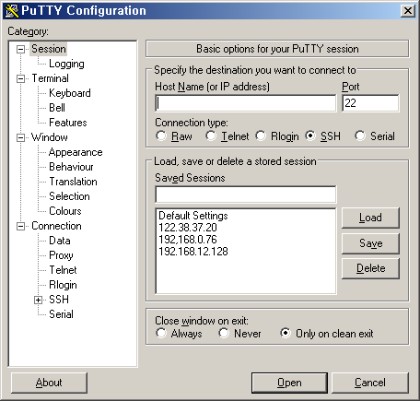
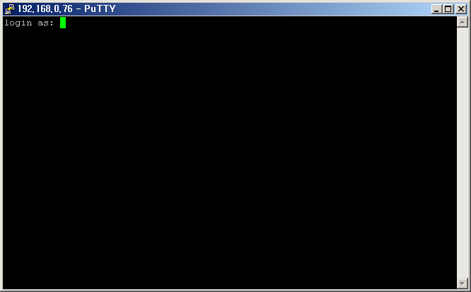
preinstall (ssh terminal 접속방법)
http://www.chiark.greenend.org.uk/~sgtatham/putty/
Ip address
192.168.0.x

Slide 7
preinstall
필수 package 설치
repo 설치
assa@ubuntu-android:~# sudo apt-get install flex bison gperf libsdl-dev libesd0-dev libwxgtk2.6-dev build-essential zip curl valgrind git-core gnupg zlib1g-dev libncurses5-dev
assa@ubuntu-android:~# mkdir bin
assa@ubuntu-android:~# curl http://android.git.kernel.org/repo >~/bin/repo
assa@ubuntu-android:~# cd bin
assa@ubuntu-android:~# chmod a+x repo //실행권한주기
assa@ubuntu-android:~# repo
error: repo is not installed. Use "repo init" to install it here. //설치확인

Slide 8
preinstall
jdk 설치
Jdk1.5, 1.6버전을 돌아가며 사용 하는일이 잦음
assa@ubuntu-android:~#chmod a+x jdk-1_6_0_20-linux-i586.bin
assa@ubuntu-android:~#./jdk-1_6_0_20-linux-i586.bin
.
.
.
assa@ubuntu-android:~#ls –l jdk1.6.0_20
total 8
drwxr-xr-x 10 root root 4096 2010-07-06 17:32 jdk1.6.0_20
assa@ubuntu-android:~#cp –rf jdk1.6.0_20 /opt

Slide 9
preinstall
Path 수정
.bashrc 에 path 경로 추가하기
assa@ubuntu-android:~#cd
assa@ubuntu-android:~#vi .bashrc
.
.
.
..
# enable programmable completion features (you don't need to enable
# this, if it's already enabled in /etc/bash.bashrc and /etc/profile
# sources /etc/bash.bashrc).
if [ -f /etc/bash_completion ]; then
. /etc/bash_completion
fi
export PATH=$PATH:/home/kmorkah/bin:/home/assa/jdk1.6.0_20/bin #jdk 1.6
#export PATH=$PATH:/home/kmorkah/bin:/home/assa/jdk1.5.0_22/bin #jdk 1.5
export JAVA_HOME=/home/assa/jdk1.6.0_20/
export JAVA_HOME=/home/assa/jdk1.6.0_20/
export USE_CCACHE=1

Slide 10
Source
repo information tree download
sync & download
assa@ubuntu-android:~#mkdir mydroid
assa@ubuntu-android:~#cd mydroid
assa@ubuntu-android:~# repo init -u git://android.git.kernel.org/platform/manifest.git
-b froyo
assa@ubuntu-android:~#repo sync

Slide 11





Source (android branch)
repo init -u git://android.git.kernel.org/platform/manifest.git -b froyo
repo sync
(branch name)

Slide 12
Complie
환경설정 적용 (적용해야 커맨드 사용가능)
Select package
assa@ubuntu-android:~/mydroid$ source build/envsetup.sh
including device/htc/dream/vendorsetup.sh
including device/htc/passion/vendorsetup.sh
including device/htc/sapphire/vendorsetup.sh
우선실행 되어야
사용가능
kmorkah@ubuntu-android:~/mydroid$ choosecombo
Build for the simulator or the device?
1. Device
2. Simulator
Which would you like? [1]

Slide 13
Complie
환경설정 적용
Build type choices are:
1. release
2. debug
Which would you like? [1]
Which product would you like? [generic]
Variant choices are:
1. user
2. userdebug
3. eng
Which would you like? [eng]
제품에 따라
여기서 선택
추가 되는
경우가 있음

Slide 14
Complie
환경설정 적용
============================================
PLATFORM_VERSION_CODENAME=REL
PLATFORM_VERSION=2.2
TARGET_PRODUCT=generic
TARGET_BUILD_VARIANT=eng
TARGET_SIMULATOR=false
TARGET_BUILD_TYPE=release
TARGET_BUILD_APPS=
TARGET_ARCH=arm
HOST_ARCH=x86
HOST_OS=linux
HOST_BUILD_TYPE=release
BUILD_ID=MASTER
============================================

Slide 15
Complie
complie
assa@ubuntu-android:~/mydroid$ make –j5
Cpu및 core갯수 +1
(보기는 쿼드코어 기준)

Slide 16
Complie
부분 complie
* 가끔 갱신이 안될 경우가 있으니 바이너리 생성 날짜보고확인
assa@ubuntu-android:~/mydroid$ source build/envsetup.sh
Android.mk가 있는 소스트리에서
assa@ubuntu-android:~/mydroid$ mmm
우선실행 되어야
사용가능

Slide 17
Output Binary
Binary 위치 android image
~/mydroid/out/target/product/generic
assa@ubuntu-android:~/mydroid/out/target/product/generic$ ls -l *.img
-rw-r--r-- 1 assa assa 164798 2010-07-07 18:44 ramdisk.img
-rw------- 1 assa assa 58836096 2010-07-07 20:10 system.img
-rw------- 1 assa assa 1491072 2010-07-07 18:05 userdata.img

Slide 18
물어보세요
?

